Slide 1
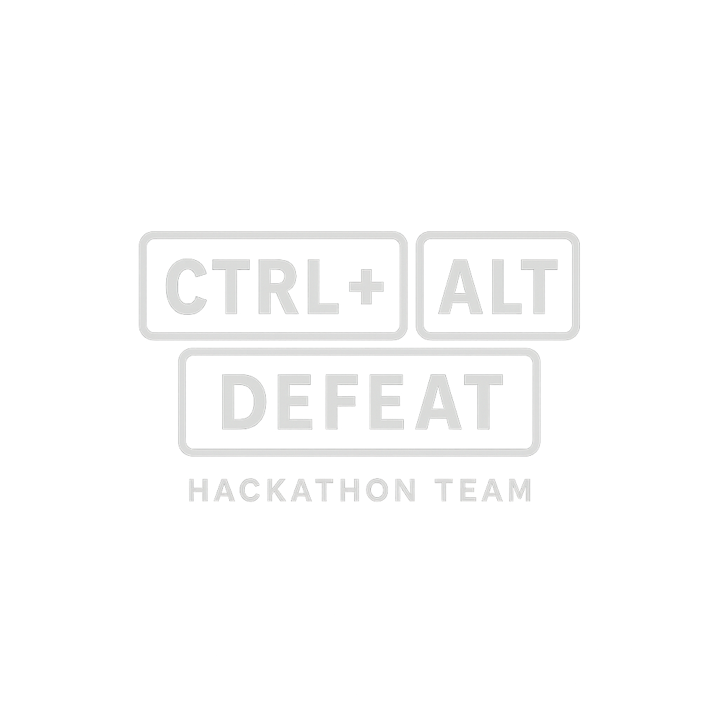
X
https://www.ctrl-alt-defeat.uk/

Slide 2
Kate Gregory Frazer-Nash
Jonathon Wright Keysight
Tom Hawkins QinetiQ
Rob Moore Dstl
Sentinel Sentinel
X
https://www.ctrl-alt-defeat.uk/

Slide 3

Mission: Replace CAA and MAA by 2036, if not sooner…
X
https://www.ctrl-alt-defeat.uk/

Slide 4
Business Case
Sentinel – AI powered Approval as a Service (AAaaS)
Currently slow and unjust decision making due to poor knowledge of technology/innovation/capability used in T&E
Providing a service to assist in decision making for the:
    Operator – guided workbench: faster documentation creation, less likely to be rejected.
    Regulator – more efficient, faster response to applications, flags residual risks, unresolved hazards, extrapolation beyond the flight-tested envelope, and weak traceability from claim to evidence. Produces a structured decision record with conditions, operating limits, review triggers, and rationale.
    Cost savings: hosting cost £35k / month. Total operating costs £250k / month << CAA and MAA.
X
https://www.ctrl-alt-defeat.uk/

Slide 5
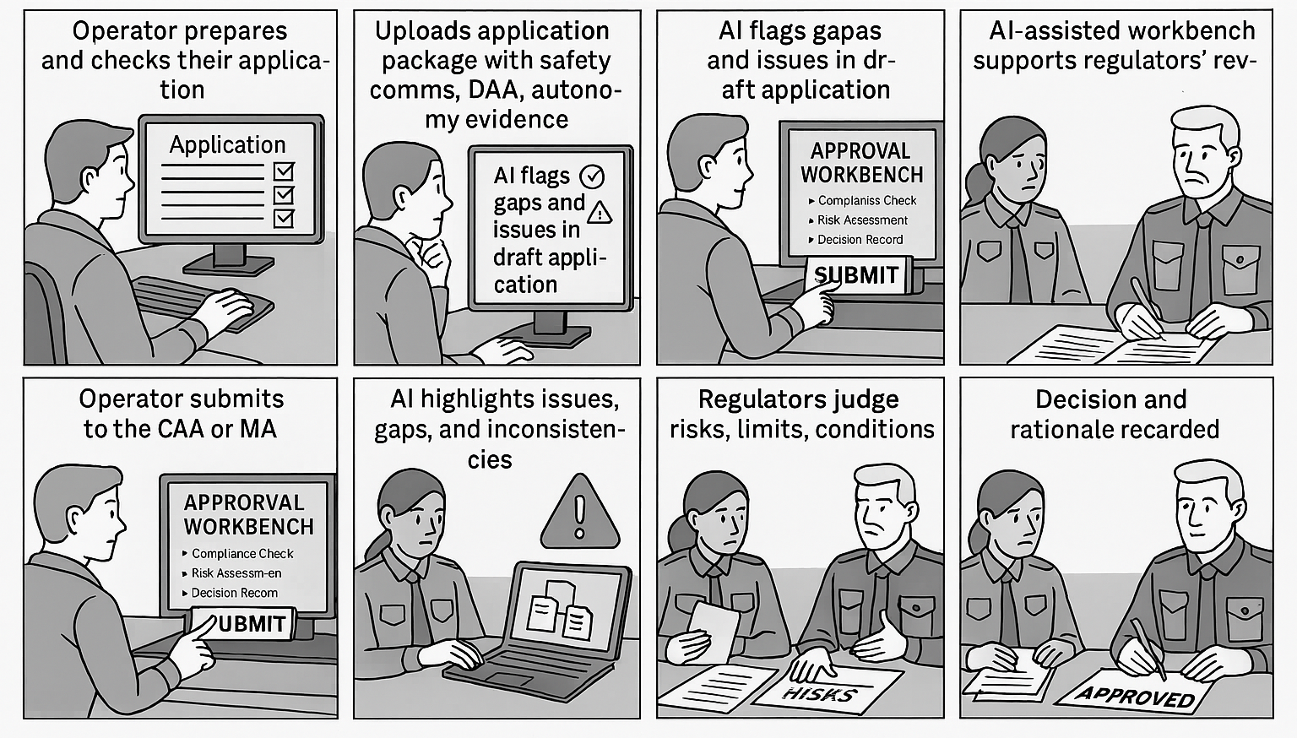
User Journey
X
https://www.ctrl-alt-defeat.uk/

Slide 6
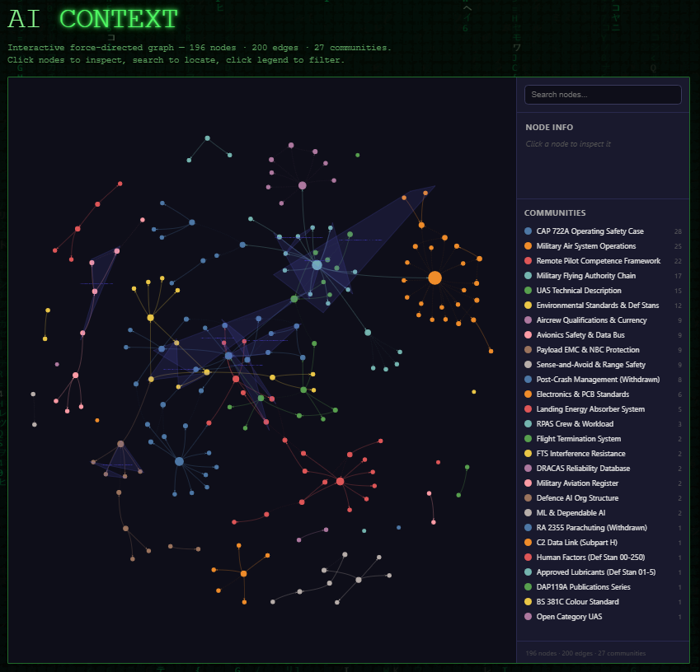
X
https://www.ctrl-alt-defeat.uk/

Slide 7




Design Plan
X
https://www.ctrl-alt-defeat.uk/

Slide 8
Safety Case | Pass/Fail | Rationale
Edinburgh Napier University 2024 | Pass | Traceability report
Uni Hertfordshire UPR HS12 2022 | Pass | Traceability report
University York 2015 | Pass | Traceability report
Kate’s Dangerous Safety Case | Fail | Duty holder not defined, missing evidence…
X
https://www.ctrl-alt-defeat.uk/

Slide 9

Sentinel Space
Authority to Space as a Service (ASaaS)
Licensing spaceflight activities (additional CAA responsibilities)
Launch operators (rockets, spaceplanes)
Return operators
Orbital operators (those who operate satellites or other space objects)
Spaceports (horizontal and vertical launch sites)
Range control services (tracking, safety, and flight termination systems)
Regulating safety and risk, applicants must provide:
Flight Safety Analysis
Ground Safety Analysis
Safety Case
Risk Assessment
PoC
Mock examples created in Copilot
Sentinel expected tomorrow
X

Slide 10
CAA Assessment (Copilot)
Document | Strengths | Key Gaps | CAA Verdict
Flight Safety Analysis | Good structure, hazards, ALARP | No quantitative modelling detail | Training‑level only
Ground Safety Analysis | Good hazard coverage | No quantification, no ESDs, no integration | Needs major expansion
Safety Case | Correct structure | No evidence, traceability, or hazard log | Not approvable
Risk Assessment | Clear and structured | No justification or linkage | Good example but incomplete
X

Slide 11
Section A
From concept to evidence — what the pipeline produced
The next 28 slides walk through the agentic platform (ctrl-alt-defeat), the 12 OpenRequirements.ai skills we invoked, and the 350+ populated deliverables that turn the Workbench concept into an audit-ready test programme.
T&E COI Hackathon · Ctrl-Alt-Defeat · OFFICIAL
29 / 78

Slide 12
ctrl-alt-defeat — the agentic platform at a glance
OFFICIAL
• An AI-agentic orchestration platform that coordinates specialised analyst agents to transform ambiguous regulatory requirements into audit-ready formal specifications
• Each "skill" dispatches 7-8 specialist analysts in parallel; findings are then cross-validated and fused into structured output
• Built around the methodology ensemble principle — DeFOSPAM, IEEE 830, SBE, Planguage, Performance Engineering, ISO 29119, TMMi — each validates a different lens on the same evidence
• Powered the entire 12-skill pipeline we ran for the CAA/MAA Joint Approval Workbench hackathon
• Repository: github.com/HyperAutomation/ctrl-alt-defeat
• Name signals "defeat ambiguity through control" + the keyboard-reboot metaphor (also the fictional operator in our SORA refusal test fixture)
T&E COI Hackathon · Ctrl-Alt-Defeat · OFFICIAL
30 / 78

Slide 13
Architecture — multi-agent orchestration
OFFICIAL
• Per-skill pattern: Phase 1 spawn foundation analysts in parallel → Phase 2 spawn dependent analysts → Phase 3 fuse findings → produce structured output (JSON + Markdown + HTML + format-specific e.g. XLSX/DOCX/PPTX/.feature)
• Agents communicate via shared JSON in an output directory (append-only)
• Each agent has: name · persona · prompt template · confidence calibration · severity rubric · output schema
• Cross-agent fusion: deduplication on finding title similarity; keep highest-confidence instance; tag with all analysts who detected it
• Regulatory-grade traceability: every claim resolves to a page/paragraph pointer in source artefacts; the emitter enforces this invariant at output time
• Interactive explorer: Neo4j graph of requirements · findings · test cases · coverage — 196 nodes across 27 communities in the CAA/MAA run
T&E COI Hackathon · Ctrl-Alt-Defeat · OFFICIAL
31 / 78

Slide 14
Tech stack
OFFICIAL
Frontend
AI / reasoning
• React 19 + TypeScript
• TanStack Start / TanStack Router
• Interactive graph viz (196 nodes, 27 communities)
• Dark-mode dashboards · heat maps
• Claude API (Anthropic)
• Per-agent personas + prompt templates
• Confidence calibration (1-10) + severity (critical/major/minor)
• Cross-validation across methodologies
Data
Runtime
• Supabase PostgreSQL — case state, audit, users
• Neo4j — requirement graph, traceability
• Append-only audit ledger
• Classification-tier-aware storage
• Cloudflare edge deployment
• UK sovereign infrastructure
• Playwright + Gherkin BDD tests
• CI: GitHub Actions + regression gates
T&E COI Hackathon · Ctrl-Alt-Defeat · OFFICIAL
32 / 78

Slide 15
The 12-skill pipeline as a flow
OFFICIAL
PHASE 1 — Understand
DeFOSPAM
Vibe
PE
SBE
125 findings
15 scales
97 findings, 8 gates
17 features / 84 scenarios
PHASE 2 — Specify + Design
SRS
Test Design
Test Plan
Create
75 FRs · RTM
25 objects · 31 techniques
40 wk · 19.1 FTE · £2.84M
194 test cases
PHASE 3 — Execute + Govern
Coverage
Templates
Management
Reporting
62.7% → 88-92%
111 artefacts
TMMi L3 · 72.6%
10 reports + RAG
T&E COI Hackathon · Ctrl-Alt-Defeat · OFFICIAL
33 / 78

Slide 16
Methodology ensemble — why 12 skills beat 1 pass
OFFICIAL
• A single LLM pass on the 20 CAA/MAA requirements produces plausible narrative but misses load-bearing defects — the skill outputs are mutually corroborating
• DeFOSPAM finds undefined terms · Vibe demands measurable scales · PE sets latency/capacity budgets · SBE makes it executable · SRS makes it IEEE 830 compliant · Design prices it · Plan schedules it · Coverage measures it · Management governs it · Reporting surfaces it
• Each methodology has a bias — different biases cancel on overlap, surface the real risks on divergence
• Twin-sample regression (Scotland vs SORA) is the release-blocker gate — every skill contributed to its definition
• Result: 350+ populated deliverables · TMMi Level 3 at design stage · 72.6% standards conformance before execution
T&E COI Hackathon · Ctrl-Alt-Defeat · OFFICIAL
34 / 78

Slide 17
Traceability invariant — every claim resolves to evidence
OFFICIAL
No output contains an unsourced quantitative assertion. The drafter refuses to emit one. Every number in every report traces to an artefact, page, and paragraph.
Layer | Example claim | Traces back to
1. Decision record | "Scotland approves at end Phase 1" | Coverage matrix · Readiness Check pass manifest
2. Test case | TC-KS-K1-001 fires with confidence 9 | Keystone K1 decision-table cell 7
3. Requirement | REQ005 "automatic containment" | CAP 722A Ed 2 §3.4 p.21 ¶3
4. Audit entry | Panel override of AI flag F-007 | Audit ledger hash 0xAB...3F · panel action log timestamp · signatory identity
This is a mathematical invariant enforced at emit-time — not a policy preference. It is what makes every output audit-ready from first draft.
T&E COI Hackathon · Ctrl-Alt-Defeat · OFFICIAL
35 / 78

Slide 18
DeFOSPAM — requirements validation
OFFICIAL
Skill 1 of 12 · Based on the Business Story Method by Paul Gerrard · 7 analyst personas
Agent | Principle | Finding types
Dorothy | D — Definitions | undefined_term · ambiguous_term · synonym_collision
Flo | F — Features | identified_feature · implied_feature · missing_feature
Olivia | O — Outcomes | identified_outcome · hanging_outcome · null_outcome
Sophia | S — Scenarios | happy_path · exception · edge_case · data_driven
Paul | P — Prediction | unpredictable_outcome · missing_default · precedence_undefined
Alexa | A — Ambiguity | vague_quantifier · weasel_word · passive_voice_hides_actor
Milarna | M — Missing | missing_feature · missing_scenario · missing_cross_cutting
125
68
56
88
Findings
Critical
Major
Glossary terms
T&E COI Hackathon · Ctrl-Alt-Defeat · OFFICIAL
36 / 78

Slide 19
DeFOSPAM — headline findings
OFFICIAL
• REQ017-REQ020 are placeholders, not user stories — public engagement, security classification, environmental impact, and post-trial close-out all flagged as absent in the source CSV itself
• Load-bearing success terms are undefined — "meaningful human control", "swarm-aware", "containment", "forensically explainable", "defensibly", "worst-credible" used as pass/fail criteria without definitions — two assessors will reach different conclusions on the same pack
• Safety-critical outcomes are unspecified — REQ005 (geofence breach action), REQ007 (DAA encounter resolution), REQ011 (independent termination) state goals but not behaviours
• No authentication, role-based access control, or audit logging is called out despite the system spanning applicant / regulator / panel / RAISO / RSO / AAIB roles with classification-sensitive evidence
• The Workbench's own assurance is silent — the meta-problem of assuring the assurance tool is not in the source REQ set
T&E COI Hackathon · Ctrl-Alt-Defeat · OFFICIAL
37 / 78

Slide 20
Vibe Requirements — Tom Gilb's Planguage
OFFICIAL
Skill 2 of 12 · Quantified value specifications · 8 analyst personas
• Each vague quality word becomes a precise numeric Scale + a Meter (measurement process) + Benchmarks (Past/Status/Record/Ideal/Trend) + Constraints (Tolerable/Survival) + Targets (Wish/Goal/Stretch) + Background + Stakeholders + QC
• Agents: Alexa (Scale) · Ray (Meter) · Brook (Benchmarks) · Isaac (Constraints) · Tom (Targets) · Raj (Background) · Alan (Stakeholders) · Lovelace (QC)
• 15 values quantified with 51 sub-scales · 19 Meters · 75 benchmark data points · 24 Constraints · 45 Targets (15× Wish/Goal/Stretch)
• Lovelace QC verdict: 63% completeness · 0.93 defects/spec · major_rework recommended
• Top priorities for workshop: MLForensicExplainability (62-point gap) · SwarmAwareSORAEvidence (65-point gap) · MeaningfulHumanControl (18 pt to Tolerable, 65 pt to Ideal)
T&E COI Hackathon · Ctrl-Alt-Defeat · OFFICIAL
38 / 78

Slide 21
Sample Planguage — GeofenceContainment
OFFICIAL
Tag: GeofenceContainment
Type: Vibe Requirement.
Ambition: "automatic containment so that a fly-away cannot become uncontrolled BVLOS" ← REQ005
Scale: % of Monte Carlo failure scenarios [FailureModes] in which airframe is contained within
defined geofence envelope [Tolerance] for [OpType] over [TimePeriod]
Unit: percentage
Meter [METER-005]: Geofence Monte Carlo Simulation (automated, quick)
Meter [METER-006]: Live fly-away breach test at range (manual, thorough)
Past: 99.2% [FY 2024]
Status: 99.6% [2026-04]
Record: 99.99% (BAE Systems Protector programme, public release)
Ideal: 100%
Trend: stable with improving trajectory (+0.1%/year)
Tolerable: 99.5% by Submission Readiness Check
Survival: 99.0%
Regulatory: 99.9% (populated-area overflight, CAP 722 v9)
Wish: 99.9% by first trial (achievable)
Goal: 99.95% by end 2027 (stretch)
Stretch: 99.99% by steady-state 2028 (stretch)
Owner: Applicant + CAA Airspace Regulator
Authority: CAA (AAA) / MAA for military legs
Priority: critical (rank 4/15) Keystone: K1
T&E COI Hackathon · Ctrl-Alt-Defeat · OFFICIAL
39 / 78

Slide 22
Performance Engineering — CLASS UME
OFFICIAL
Skill 3 of 12 · Effective Performance Engineering (DeCapua & Evans) · 8 disciplines
Discipline | Analyst | Findings
C — Capacity | Ada | 11 — Workbench + swarm capacity models
L — Latency | Noyce | 14 — SLA budgets · 20 performance budgets
A — Availability | Alan | 10 — 99.9% targets · RTO/RPO · failover
S — Scalability | Liskov | 11 — breakpoint · 5x/10x growth
S — Security | Yao | 10 — classification boundary · OWASP · red-team
U — Usability | Turing | 16 — applicant / regulator UX · WCAG 2.2 AA
M — Monitoring | Iverson | 16 — APM · RUM · drift · calibration
E — Endurance | Cerf | 9 — Gates 1-8 · 72-hour soak · twin-sample regression
Total: 220 NFR artefacts · 97 findings (30 critical · 64 major · 3 minor) · 8 binding quality gates
T&E COI Hackathon · Ctrl-Alt-Defeat · OFFICIAL
40 / 78

Slide 23
PE key SLAs — the numbers that bind the release
OFFICIAL
Workbench (service)
Swarm (operational system being approved)
Journey | p95 target
Workspace creation | <3 s
Submission upload (100 MB) | <30 s
Coverage matrix generation | <10 min
Panel case-open | <10 s
AI flag narrative | <30 min
Evidence pointer resolution | <2 s
Panel action log write | <500 ms (at risk)
Decision record PDF export | <5 min
Full panel review cycle | <2 working days
Safety-critical loop | p99 target
Geofence breach → action | <500 ms (hard 1 s)
C2 round-trip (tactical) | <1 s
DAA cooperative encounter | <5 s
DAA non-cooperative | <30 s
Flight termination → motor cutoff | <500 ms
Swarm consensus cycle | aligned with control loop
Panel action log SLA at risk: distributed consensus + TSA timestamp + classification check exceed 500 ms — flagged by Noyce, Liskov, and Yao independently.
T&E COI Hackathon · Ctrl-Alt-Defeat · OFFICIAL
41 / 78

Slide 24
Specification by Example — Gherkin + Living Docs
OFFICIAL
Skill 4 of 12 · Gojko Adzic methodology · 7 SBE agents (Grace · Chris · Isabel · Rex · Angie · Victoria · Laveena)
• Grace derived 15 business goals from the 20 REQs
• Chris canonicalised 42 ubiquitous-language terms and recommended 10 workshops
• Isabel produced 15 concrete worked examples with realistic data (Scotland + CTRL-ALT-DEFEAT fixtures used throughout)
• Rex refined all 69 DeFOSPAM scenarios to IEEE-quality (avg quality 7.90/10)
• angie emitted 17 Gherkin .feature files / 84 scenarios organised by business capability — applicant · SORA assessment · containment & safety · autonomy · panel review · post-decision · classification · governance
• Victoria assigned scenarios to suites — 10 smoke (<5 min) · 55 regression (<30 min) · 69 full (<2 hours)
• Laveena structured the Living Documentation navigation across the 10-step Workbench service blueprint
T&E COI Hackathon · Ctrl-Alt-Defeat · OFFICIAL
42 / 78

Slide 25
SBE twin-sample fixtures — the canonical test data
OFFICIAL
Scotland (approve path)
CTRL-ALT-DEFEAT (refuse path)
• Edinburgh Napier University Operating Safety Case v2.2
• PDRA-01 Specific Category · VLOS
• 3 aircraft: DJI Matrice 350 RTK · DJI Mini 3 Pro · DJI Mavic 3E
• Class G/D airspace · Merchiston Campus
• GVC-qualified crew: Davison · Barreto · Leak
• Named accountable manager · SMS per CAP 1059
• Expected outcome: APPROVE with PDRA-01 conditions
• CTRL-ALT-DEFEAT Spadeadam BVLOS swarm trial
• 5× RigiTech Eiger · autonomous
• GNSS + C2 deliberately denied during trial
• Declared SAIL I on SORA v2.0 (obsolete)
• Only 6 of 24 OSOs addressed
• No DAA evidence · no AMLAS case · no swarm envelope
• No named DDH · no RAISO sign-off · no apportionment
• Expected outcome: REFUSE — keystones K1/K2/K3/K7/K8 fire
T&E COI Hackathon · Ctrl-Alt-Defeat · OFFICIAL
43 / 78

Slide 26
IEEE 830 SRS — formal requirements specification
OFFICIAL
Skill 5 of 12 · 8 analysts assessing the 8 characteristics of a good SRS
Characteristic | Agent | Score | Status
C — Correct | Chelcie | 41% | FAIL
U — Unambiguous | Odin | 0% | FAIL
C — Complete | Lucy | 44% | FAIL
C — Consistent | Ophellia | 45% | FAIL
R — Ranked | Natasha | 74% | WARN
V — Verifiable | Iris | 49% | FAIL
M — Modifiable | Amelia | 48% | FAIL
T — Traceable | Lewis | 62% | FAIL
45%
Overall IEEE 830 score
75
Functional requirements assigned
20
Formal IEEE-style rewrites
Harsh score reflects ambiguity in the source text. Odin's 20 rewrites + 3 stakeholder workshops would lift most characteristics into PASS.
T&E COI Hackathon · Ctrl-Alt-Defeat · OFFICIAL
44 / 78

Slide 27
SRS — section coverage + RTM
OFFICIAL
IEEE 830 section coverage
13
8
0
Populated
Partial
Empty
Section coverage: 88% across 21 IEEE 830 sections
Requirements Traceability Matrix (Lewis)
• 20 REQs traced backward (source → DeFOSPAM feature → findings → standards) and forward (→ SBE Gherkin → PE NFR → acceptance criteria → test cases)
• 14 complete traces · 6 dead-ends (REQ003, REQ004, REQ012, REQ013, REQ014, REQ019 — require Gherkin scenarios or formal deferral)
• REQ016 flagged as single-point-of-failure (dependency score 5) — phased-gate logic affects 5 other REQs
• Apportionment: v1.0 (5 REQs) · v1.0-minor (3) · v1.1 (7) · v2.0 (5)
T&E COI Hackathon · Ctrl-Alt-Defeat · OFFICIAL
45 / 78

Slide 28
Test Design Strategy — STRATEGY pipeline
OFFICIAL
Skill 6 of 12 · 8 agents · ISO 29119 + TMap
Stage | Agent | Output
S — Scope | S_scope | 25 test objects · ISO 25010 mapped
T — Technique | T_technique | 31 test design techniques
R — Risk | R_risk | 18 Class A · 2 Class B · 1 Class C
A — Approach | A_approach | Test Strategy Table + QEST (8 × 8 rows)
T — Testability | T_testability | Composite 7.4 / 10
E — Estimation | E_estimation | 1,605 Test Points · 4,094 hours
G — Governance | G_governance | ARCI (13 activities) + 5 policies
Y — Yield | Y_yield | 12 quality gates · 13 checklist items
72% of test objects are Class A — this is a high-stakes regulatory decision-support system with hard safety implications.
T&E COI Hackathon · Ctrl-Alt-Defeat · OFFICIAL
46 / 78

Slide 29
Strategy — the numbers that bind the programme
OFFICIAL
25
31
18
12
Test objects
Test techniques
Class A risks (thorough coverage)
Quality gates
£2.84M
4,094 h
19.1 FTE
40 weeks
Programme cost
Total effort
Team size
Schedule to v1.0
Monthly run-rate: ~£229,200 · Estimated monthly env cost: £48,800
T&E COI Hackathon · Ctrl-Alt-Defeat · OFFICIAL
47 / 78

Slide 30
Test Plan — PLANNED pipeline
OFFICIAL
Skill 7 of 12 · 7 agents · ISO 29119-3 + TMap
• P_plan — Master Test Plan (40 weeks · 23 milestones · 8 phases · 12 entry / 13 exit criteria)
• L_levels — 6 Level Test Plans: L1 Unit (240h) · L2 Component (360h) · L3 Integration (480h) · L4 System (960h) · L5 SIT (320h) · L6 UAT (120h) = 2,480 core hours
• A_allocation — 19.1 FTE team + £2.84M budget (Labour £1.59M · Infra £400k · Tools £148k · Red-team £120k · Assessor £80k · Classified enclave £200k · Other £292k · Contingency 5%)
• N_nonfunctional — 61-row NFT matrix across Performance, Security, Usability, Accessibility, Reliability, Capacity, Scalability
• N_network — 10 E2E chain cards + 20 integration pairs + data flow + SPOFs identified (Clause Library versioning · Audit Ledger durability · Archive WORM)
• E_environment — 6 environments (Dev / QA / Perf / SIT / UAT / Classified)
• D_data — 10 data packages / ~240 GB synthetic · Scotland + CTRL-ALT-DEFEAT twin-sample fixtures
T&E COI Hackathon · Ctrl-Alt-Defeat · OFFICIAL
48 / 78

Slide 31
PLANNED — 90-day classified enclave lead time is the critical path
OFFICIAL
Environment | Tier | Monthly | Lead time
Dev | OFFICIAL | £300 | 1 day
QA / Test | OFFICIAL | £6,000 | 10 days
Perf Test | OFFICIAL (dedicated) | £15,000 | 20 days
SIT | OFFICIAL + SECRET bridge | £7,500 | 30 days
UAT | OFFICIAL (production-like) | £12,000 | 45 days
Classified enclave | SECRET / STRAP | £8,000 | 90 days
Monthly environment total: £48,800
Critical path: Classified enclave procurement must start Week 1 — 90-day MOD/JSP 440 accreditation lead time is the binding schedule constraint for L5 SIT and L6 UAT completion.
T&E COI Hackathon · Ctrl-Alt-Defeat · OFFICIAL
49 / 78

Slide 32
Test Cases (CREATES) — 194 concrete test cases
OFFICIAL
Skill 8 of 12 · 7 CREATES agents (Context · Rules · Enumerate · Author · Trace · Export · Score)
194
77%
90
100
Total test cases
Automation rate
Critical priority
High priority
Domain | Count | Focus
Keystones (K1-K8) | 36 | Refusal detectors — release-blocker Gate 9
Functional | 73 | 67 of 75 FRs (89%) across Phase 1/2/3 journeys
NFR / Performance | 48 | 8 Cerf gates + 20 Noyce SLAs + WCAG 2.2 AA
Twin-sample regression | 37 | Cerf Gate 8 — Scotland approves + SORA refuses <30 min
Each test case carries: ID · Title · Technique · Priority · Level · Automated flag · Precondition · Input · Action · Expected Result · Parent REQ · Keystone · SBE Gherkin link
T&E COI Hackathon · Ctrl-Alt-Defeat · OFFICIAL
50 / 78

Slide 33
Keystones K1-K8 — non-negotiable refusal detectors
OFFICIAL
K# | Detector | Triggers on
K1 | Geofence / containment independence | Shared compute between autonomy and geofence path
K2 | DAA ML provenance and calibration | No training dataset sheet / no OOD monitor / no calibration
K3 | Swarm emergent-behaviour bounds | No simulation + flight-test coverage · no runtime monitor
K4 | ML forensic explainability | No AMLAS case · no decision logging · no reconstruction path
K5 | Meaningful Human Control operationalisation | No override latency evidence · no authority matrix · no workload
K6 | Independent flight termination | Termination shares compute or RF path with autonomy
K7 | CAA/MAA apportionment (as a gate) | Unsigned apportionment for boundary-crossing operation
K8 | Classification custodian | No custodian named · no redaction protocol · no two-person rule
Any one keystone firing at confidence ≥9 blocks approval. They are individually sufficient and jointly redundant — a clever applicant cannot satisfice one while ignoring others. All 8 fire on the CTRL-ALT-DEFEAT sample; all 8 stay silent (N/A) on Scotland.
T&E COI Hackathon · Ctrl-Alt-Defeat · OFFICIAL
51 / 78

Slide 34
Coverage Analysis — COVERED pipeline
OFFICIAL
Skill 9 of 12 · 7 agents · TMap coverage groups + ISO 25010
62.7%
18/20
6/8
8/12
Adequacy
REQs covered
Keystones OK
Gates passing
Verdict: MAJOR GAPS — Block Release (below 85% release threshold)
10 recommendations / 25 new test cases / 98 hours lift adequacy to 88-92% — above release threshold
• REC-001 REQ013 Insurance & Ground Survey — 5 TCs · 14 h (quick win · 85% lift)
• REC-002 REQ014 Crew Training & Competency — 5 TCs · 15 h (quick win · 80% lift)
• REC-003 Orphan TC traceability (37 tags → RTM) — 4 h (quickest win)
• REC-004 / REC-005 — K7 + K8 keystones +2 TCs each
• REC-006 Gate 11 Classification 2-person review — 3 TCs · 12 h
T&E COI Hackathon · Ctrl-Alt-Defeat · OFFICIAL
52 / 78

Slide 35
COVERED — heat maps (REQ / keystone / gate)
OFFICIAL
REQ coverage (18 of 20)
REQ001
REQ002
REQ003
REQ004
REQ005
REQ006
REQ007
REQ008
REQ009
REQ010
REQ011
REQ012
REQ013
REQ014
REQ015
REQ016
REQ017
REQ018
REQ019
REQ020
Keystones K1-K8
K1
K2
K3
K4
K5
K6
K7
K8
Quality Gates 1-12
G1
G2
G3
G4
G5
G6
G7
G8
G9
G10
G11
G12
Legend: GREEN ≥90% · AMBER 60-90% · RED <60%. REQ013/014 uncovered · K7/K8 partial · G1/G11/G12 pending execution · REQ017/019 newly authored as absent-by-default.
T&E COI Hackathon · Ctrl-Alt-Defeat · OFFICIAL
53 / 78

Slide 36
111 test templates — every artefact a regulator could request
OFFICIAL
Skill 10 of 12 · 8 TEMPLATE agents
Category | Count | Examples
Technique | 8 | Decision tables · State transition · MCDC · Path testing · Classification tree
Execution | 12 | Test case log · Test scripts · Test scenarios · Coverage matrix · Gherkin acceptance
Exploratory | 9 | Charters (full / simple / PDF / risk-based) · Debriefing · Session log · Capacity
Defect management | 5 | Anomaly admin · Defect process · JIRA log · JIRA process · Defect summary
Checklists | 22 | Quality · Security · Performance · Accessibility · API · DB · Automation · UAT · Go-live
Strategy & planning | 13 | TST · QEST · Intensity · MTP · Agile plan · WSJF · Estimation · Release
Accountability | 5 | ARCI · QAM · QPM · Governance matrix · Policies
Traceability | 7 | RTM · Coverage map · Risk-to-test · Heat map · Compliance · Bidirectional
Reporting & metrics | 9 | Execution · Daily status · Metrics · Defect summary · Trends · Burndown · MTR
E2E / Integration | 3 | E2E chain · Integration matrix · API chain
Estimation & capacity | 3 | 3-point · Capacity · T-shirt sizing
Level test plans + Ops | 12 | L1-L6 LTPs · Incident playbook · Release readiness · Provisioning · Runbooks
Meta-index | 2 | templates-catalogue.xlsx · templates-index.html
Total 111 XLSX / DOCX / HTML artefacts — 1.48 MB · 0 validation errors · all populated with real pipeline data
T&E COI Hackathon · Ctrl-Alt-Defeat · OFFICIAL
54 / 78

Slide 37
Test Management — MANAGES pipeline
OFFICIAL
Skill 11 of 12 · TMMi + ISO 29119 + IEEE + TMap · 7 agents
3
72.6%
25
25
TMMi Level
Standards conformance
Efficiency metrics
Improvement actions
Projected release advice (synthetic Week 38): CONDITIONAL GO
• TMMi Level 3 (Defined) achieved at design stage — unusually high for a greenfield programme
• Level 2 Managed (5/5) + Level 3 Defined (5/5) PAs satisfied · Level 4 Measured designed · Level 5 Optimization partial
• 16 standards evaluated · 100% conformance on CAP 722A · CAP 1616 · IEEE 1044.1 · 40% on IEEE 1028 reviews (biggest gap)
• 25 improvement actions / 3,506 hours / 7 quick wins + 7 strategic + 11 fill-ins / 0 deprioritised
• Top 5 priority actions: (1) classified enclave procurement · (2) multi-GPU load balancing · (3) panel action log async durability · (4) coverage gap closure · (5) AI + Classification SME recruitment
• Maturity projection: Level 4 (Measured) by end 2027 · Level 4.5 by end 2028
T&E COI Hackathon · Ctrl-Alt-Defeat · OFFICIAL
55 / 78

Slide 38
Test Reporting — REPORTS pipeline
OFFICIAL
Skill 12 of 12 · 7 agents · IEEE 829-2008 MTR + RAG dashboards
• R_realtime — live RAG dashboard + 40-week snapshot template · keystone + gate status tracking
• E_execution_status — breakdowns by test level / type / priority / feature / sprint · defect summary matrix
• P_product_quality — ISO 25010 × 8 characteristics assessment · 13-item exit criteria · 12 gate status · twin-sample tracking
• O_outcome — IEEE 829-style Release Advice (GO / CONDITIONAL GO / NO GO) · 5-stakeholder sign-off block
• R_risk_report — risk mitigation matrix · exposure trend · risk-based coverage · keystone risk status
• T_trend — 7 native XLSX charts: defect discovery vs resolution · velocity · arrival rate · coverage growth · age histogram · Pareto · moving averages
• S_summary — full IEEE 829-2008 Master Test Report (42 pages fully populated retrospective template)
• Synthetic Week 38 snapshot: CONDITIONAL GO · 93% pass · 0 critical · 91% adequacy · 11/12 gates green · twin-sample 28 min end-to-end
T&E COI Hackathon · Ctrl-Alt-Defeat · OFFICIAL
56 / 78

Slide 39
Section C
The twin-sample thesis
A well-formed approval Workbench must approve Scotland and refuse CTRL-ALT-DEFEAT — end-to-end, in under 30 minutes, on every release. The next 6 slides explain why.
T&E COI Hackathon · Ctrl-Alt-Defeat · OFFICIAL
57 / 78

Slide 40
Scotland — the approve-path fixture
OFFICIAL
• Real source: Edinburgh Napier University UAS Operating Safety Case v2.2 (14 Jun 2024)
• Authorisation: UKPDRA-01 · Specific Category · VLOS only
• Fleet: DJI Matrice 350 RTK (9.2 kg) · DJI Mini 3 Pro (249 g) · DJI Mavic 3E (1050 g)
• Airspace: Class G + Class D · NSF process where needed
• Named Accountable Manager (Brian Davison) + 2 Remote Pilots with GVC qualifications
• Safety Management System aligned to CAP 1059 · No Accidents target
• 11 documented emergency procedures: pilot incapacitation · airspace incursion · ground incursion · loss of link · rogue RPA · LiPo fault · loss of GNSS · compass error · abnormal environmental conditions · ...
• Change log back to v0.1 · occurrence reporting via ECCAIRS · IMSAFE self-assessment
• Expected Workbench outcome: APPROVE with standard PDRA-01 conditions
T&E COI Hackathon · Ctrl-Alt-Defeat · OFFICIAL
58 / 78

Slide 41
CTRL-ALT-DEFEAT — the refuse-path fixture
OFFICIAL
• Fictional operator "CTRL-ALT-DEFEAT" — BVLOS autonomous swarm trial at Spadeadam Test Range (MOD site)
• 5× RigiTech Eiger autonomous aircraft · MTOM <25 kg each
• Mission profile includes DELIBERATE simulated GNSS and C2 denial
• Declared SAIL I on JARUS SORA v2.0 (obsolete — v2.5 current)
• Only 6 of 24 OSOs addressed · OSO 10 "partially met" with a one-line rationale
• NO DAA evidence · NO C2 link budget · NO swarm behaviour envelope · NO AMLAS/SACE case
• No named Accountable Manager · no DDH/ODH · no RAISO sign-off · no Range Safety Officer identity
• Treats "segregated airspace" as a blanket risk-eraser (it is not — it does not eliminate emergent behaviour, geofence breach, or termination-to-boundary failure)
• Expected Workbench outcome: REFUSE — over-determined by keystones K1, K2, K3, K7, K8
T&E COI Hackathon · Ctrl-Alt-Defeat · OFFICIAL
59 / 78

Slide 42
Why the Workbench refuses CTRL-ALT-DEFEAT — keystone detectors fire
OFFICIAL
Keystone | Fires because... | Confidence
K1 Geofence independence | "Hard geofencing" claimed without independence evidence · no test of enforcement under degraded state | 10
K2 DAA ML provenance | No DAA report · no training dataset sheet · no calibration study · no OOD monitor | 10
K3 Swarm emergent-behaviour bounds | No simulation coverage · no flight-test coverage · no runtime monitor · swarm state space unexplored | 10
K4 ML forensic explainability | No AMLAS/SACE case · no ODD · no decision logging design · no MHC concept | 10
K5 Meaningful Human Control | "Remote Pilot / Mission Supervisor" named without MHC model · no override latency evidence | 9
K6 Independent flight termination | Termination mentioned in passing · independence unevidenced · no FMEA / fault-injection | 9
K7 CAA/MAA apportionment | Military-range operation with no signed apportionment between CAA civil and MAA military authority | 10
K8 Classification custodian | Classified-adjacent range operation · no custodian · no classification guide · no two-person rule | 10
Refusal is over-determined. Each keystone independently and jointly blocks approval with confidence ≥9. No single fix can make this submission approvable — it requires re-derived SAIL + full artefact set.
T&E COI Hackathon · Ctrl-Alt-Defeat · OFFICIAL
60 / 78

Slide 43
10 E2E chain cards — the full business flows tested
OFFICIAL
Chain ID | Flow | Level
E2E-01 | Applicant Phase 1 happy path (Scotland 100 MB) → approve | L4/L6
E2E-02 | Applicant Phase 1 refuse path (CTRL-ALT-DEFEAT) → keystones fire | L4/L6
E2E-03 | Joint panel Phase 2 approval cycle with deliberation + override | L4/L6
E2E-04 | Joint panel Phase 2 refuse cycle with refuse-with-reasons draft | L4/L6
E2E-05 | Post-decision archive to UK sovereign WORM storage | L5
E2E-06 | Classification-aware SECRET upload (MOD / GCAP pattern) | L5
E2E-07 | Clause library revision publish with in-flight pin | L5
E2E-08 | AAIB post-incident forensic export | L5
E2E-09 | Drift alert response (regulator override rate >40%) | L4
E2E-10 | Red-team probe during live panel — SLA holds | L5
SPOFs identified: (1) Clause Library version drift breaks coverage matrix + archive reproducibility · (2) Audit Ledger write-ahead log unavailable halts Phase 2-3 · (3) Archive WORM storage unavailable prevents decision record writes.
T&E COI Hackathon · Ctrl-Alt-Defeat · OFFICIAL
61 / 78

Slide 44
Twin-sample regression — the release-blocker backbone
OFFICIAL
• Every release candidate must pass the twin-sample regression end-to-end in under 30 minutes. No exceptions. This is Cerf Performance Gate 8 and Y_yield Gate 8.
• Scotland runs end-to-end: workspace → upload → coverage matrix (green) → Readiness Check pass → panel case-open → deliberation → decision record (approve-with-conditions) → archive. Target <30 min.
• CTRL-ALT-DEFEAT runs end-to-end: workspace → upload → coverage matrix (reds) → keystones K1/K2/K3/K7/K8 fire at confidence ≥9 → panel confirms refusal → decision record (refuse-with-reasons). Target <30 min.
• 37 concrete test cases in the twin-sample pack (TEMPLATES > test-case-log.xlsx). 77% automated; UAT panel session manual.
• The pack is deliberately over-determined: any one of 8 keystones independently refuses SORA. No single keystone repair can slip the refusal through.
• Scotland cannot false-refuse: keystones are silent (N/A path) on PDRA-01 VLOS. If a keystone fires on Scotland the regression is red regardless of timing.
• When both cases run green end-to-end in <30 min and the pack hashes verify, the release gate opens. Otherwise: hold.
T&E COI Hackathon · Ctrl-Alt-Defeat · OFFICIAL
62 / 78

Slide 45
Section D
How it all composes
The platform depth — from the Neo4j requirement graph, through the interactive visualisations, to the regulatory anchors and classification-aware security posture.
T&E COI Hackathon · Ctrl-Alt-Defeat · OFFICIAL
63 / 78

Slide 46
Data model — Neo4j requirement graph
OFFICIAL
• 196 nodes representing requirements, features, findings, test cases, coverage edges
• 27 requirement communities (clusters by semantic proximity) revealed by graph algorithms
• Each edge typed: REFINES · CONSTRAINS · SATISFIES · TRACES_TO · COVERS · CONFLICTS_WITH · DEPENDS_ON
• Queryable via Cypher — "show me all test cases that cover REQ005 including indirect paths via FR decomposition"
• Powers the interactive explorer in the AI Context view — drag/zoom · click to pin a community
• Traceability invariant enforced at graph-write time — every finding must resolve to a source node
• Graph regenerates per clause-library revision · in-flight cases pinned to their revision graph
T&E COI Hackathon · Ctrl-Alt-Defeat · OFFICIAL
64 / 78

Slide 47
Interactive visualisations — live explorer surfaces
OFFICIAL
Surface | Purpose | Interactivity
AI Context graph | 196-node requirement graph explorer | Drag · zoom · click to isolate community · hover for tooltip
Coverage heat map | REQ × test case coverage density | Click a REQ to drill to its test cases + gaps
Keystone dashboard | K1-K8 refusal detector status per release | Click a keystone to see its decision-table cells
Gate timeline | 12 gates × 40 weeks schedule vs actual | Per-gate status · drill to gate evidence
Audit ledger viewer | Immutable panel deliberation log | Filter by case · inspector · time window
RAG dashboard | Real-time programme status | Drill into any amber/red metric for root cause
Decision record preview | WYSIWYG panel view of draft decision | Hover a quantitative claim to see source evidence
T&E COI Hackathon · Ctrl-Alt-Defeat · OFFICIAL
65 / 78

Slide 48
Regulatory anchors — the clause library
OFFICIAL
Civil aviation
Military aviation
› CAP 722 v9 (UAS operations)
› CAP 722A Second Edition (Operating Safety Cases)
› CAP 722B Fifth Edition (RAE Competence)
› CAP 1616 (Airspace Change)
› ANO 2016/765 + Assimilated Reg (EU) 2019/947
› CAP 722H (Classified UAS)
› CAP 1789A (UAS Implementing Reg UK)
› RA 1000 series (Regulatory Principles · Duty Holders)
› RA 1600 series (RPAS airworthiness)
› RA 2000 series (Flying regulations)
› RA 2325 / 2335 (Flight Test Permits)
› DEFSTAN 00-970 Part 9 Issue 13 (RPAS design)
› JSP 440 (Security)
› JSP 936 Part 1 v1.1 (Dependable AI)
Standards + AI
Weapons + law
› JARUS SORA v2.5 (24 Operational Safety Objectives)
› AMLAS 6-stage (York · CAA)
› SACE 8-stage (Centre for Assuring Autonomy)
› DO-365 (DAA minimum ops)
› ASTM F3442 (DAA technical framework)
› EUROCAE ED-267 (DAA)
› AOP-15 (NATO weapon safety)
› Article 36 (Additional Protocol I · Geneva)
› GDPR / UK DPA 2018
› CAP 382 (Mandatory Occurrence Reporting)
T&E COI Hackathon · Ctrl-Alt-Defeat · OFFICIAL
66 / 78

Slide 49
Evidence traceability invariant — walked end to end
OFFICIAL
A decision record claim: "Scotland pack satisfies Readiness Check at 08:42 UTC on 2026-04-23"
Layer | Resolves to
1. Decision Record claim | Scotland pack satisfies Readiness Check
2. Readiness Check manifest | Artefact coverage 100% · Duty Holder signed · Revision pinned v2.1 · Class OFFICIAL · No open edits
3. Coverage matrix | Every mandatory artefact per CAP 722A §3-4 present with page/paragraph pointers
4. Artefact Detector run log | Document-by-document parse results with hashes
5. Source evidence pack | Scotland OSC v2.2 · 3 aircraft manuals · Brian Davison accountable manager cert · insurance policy UM176/17
6. Clause library revision | CAP 722A Second Edition · Dec 2022 · pinned in case state
7. Signature chain | Duty Holder cryptographic signature + audit ledger hash 0xA3...9F
Every number in every Workbench output resolves through this chain. No exceptions. No unsourced quantitative assertions.
T&E COI Hackathon · Ctrl-Alt-Defeat · OFFICIAL
67 / 78

Slide 50
Security posture — UK sovereign · classification-tier-aware
OFFICIAL
Classification | Environment | Controls | Access
OFFICIAL | UK sovereign cloud | TLS · OAuth · RBAC · WAF · SAST/DAST | CAA/MAA workforce with standard clearance
OFFICIAL-SENSITIVE | UK sovereign cloud (ACL-gated) | + classification marking + redaction protocol + audit | Named role access · classification custodian
SECRET | On-prem air-gapped enclave | + physical HW isolation · two-person review · no internet | SC-cleared staff · Classification SME + MOD liaison
STRAP-eligible | MOD-owned enclave | + MOD physical custody · Classification guide mandatory | DV-cleared + named custodian + two-person downgrade
• Hard isolation across tiers · no cross-tier data flow · no cached credentials across boundaries
• Red-team exercise (NCSC-registered) pre-v1.0 · quarterly thereafter · coordinated with SOC to tag probe traffic
• Audit ledger cryptographic timestamp per RFC 3161 · immutable append-only
• Classification two-person review is a release blocker (G_governance policy P4)
T&E COI Hackathon · Ctrl-Alt-Defeat · OFFICIAL
68 / 78

Slide 51
Section E
Approval-as-a-Service, refreshed
The business case revisited with the concrete numbers from the 12-skill pipeline. What Sentinel costs, what it saves, what it changes for operators and regulators.
T&E COI Hackathon · Ctrl-Alt-Defeat · OFFICIAL
69 / 78

Slide 52
Programme economics — what it costs to build
OFFICIAL
£2.84M
40 weeks
19.1
£229k
Programme cost
Schedule
FTE
Monthly run rate
Category | GBP
Labour (19.1 FTE × 40 weeks) | £1,590,000
Infrastructure (Dev/QA/Perf/SIT/UAT) | £400,000
Tools & licences | £148,000
Red-team (NCSC-registered) | £120,000
Independent assessor (MAA-CTS / QinetiQ) | £80,000
Classified enclave provisioning | £200,000
Penetration testing · assistive-tech · RF lab | £135,000
Training + contractor support | £165,000
Contingency 5% | £142,000
Total | £2,840,000
Team structure
› 1 Workbench Test Manager
› 1 QA Lead
› 2 Senior Functional FTE
› 4.6 Functional Engineers
› 4.9 Performance Engineers
› 3.3 Security Engineers
› 1.6 Accessibility Specialists
› 0.5 Independent Assessor (MAA-CTS)
› 0.25 Classification SME
T&E COI Hackathon · Ctrl-Alt-Defeat · OFFICIAL
70 / 78

Slide 53
Automation ROI — 500% Year 1 · breakeven Month 2
OFFICIAL
77%
500%
1,100%+
Month 2
Automation rate
Year 1 ROI
Year 2+ ROI
Breakeven
Investment vs saved
Category | Year 1 | Rationale
Automation investment | ~£100,000 | 800 hours engineering + framework tooling (Behave / Playwright / K6 / Axe / Allure)
Manual cost saved | ~£600,000 | 2,480 regression-hours that would be re-run manually · £242/h equivalent cost
Net Year 1 ROI | £500,000 | 500% return
Year 2+ annual ROI | ~£1.1M+ | Framework investment fixed · regression cycles recur per clause-library revision
Cost per defect estimate: £2,360 - £7,100 (midpoint £4,700) — high end of industry benchmark reflects regulatory safety-critical nature
T&E COI Hackathon · Ctrl-Alt-Defeat · OFFICIAL
71 / 78

Slide 54
Cost per decision — status quo vs Sentinel
OFFICIAL
Status quo — a bespoke BVLOS swarm approval today
• Typical 6-12 months of senior-inspector time across MAA + CAA
• Senior inspector-day estimated at £800-1,500 (fully-burdened)
• 3-5 inspectors × 3-6 months × 80% allocation = ~£400k-£1.2M inspector effort per approval
• Plus applicant rework cycles (weeks of CAA correspondence · specialist advisor fees)
Sentinel — with the Workbench running at steady state
• Panel session typically 1-2 working days (NFR target)
• Applicant pre-submission Phase 1 iteratively refines pack · non-punitive private feedback loop
• Shared inspector time estimated at ~£30-80k per approval at steady state
• Plus amortised Workbench operations ~£48,800/month → ~£5k per approval at 10-approval/month throughput
• Estimated saving: 80-95% per approval at steady state
The saving compounds as adoption grows — same infrastructure serves more approvals · calibration loop improves decision consistency across cases.
T&E COI Hackathon · Ctrl-Alt-Defeat · OFFICIAL
72 / 78

Slide 55
Roadmap — v1.0 through v2.0
OFFICIAL
Release | Target | Scope | REQs included
v1.0 | End 2026 | Foundations · K1 · K6 · AC1 · AC2 core · first live joint panel | 5 REQs
v1.0-minor | Q1-Q2 2027 | AC3-AC8 expansion · K2-K5 · swarm-aware SORA | 3 REQs
v1.1 | End 2027 | Full calibration loop · REQ017-020 authored · TMMi Level 4 | 7 REQs
v2.0 | Future | Coalition swarm (AUKUS / NATO) · urban BVLOS (CAP 722C) · maritime variant | 5 REQs
• Every version crosses the 12 quality gates + twin-sample regression before release
• Clause library versioning: in-flight cases pin to their revision · new cases use current
• Calibration cycle: regulator overrides feed quarterly review · no self-learning in safety decisions (§23 of the plan)
• Coalition swarm variant (v2.0) would require a decision-record interop schema for peer regulators
T&E COI Hackathon · Ctrl-Alt-Defeat · OFFICIAL
73 / 78

Slide 56
Top 5 programme risks
OFFICIAL
# | Risk | Mitigation
1 | Classified enclave 90-day procurement lead time (critical path) | Submit MOD request Week 1 · parallel-path OFFICIAL-only testing during provisioning · pre-brief classification custodian · fast-track MOD sponsorship
2 | AI test engineer + Classification SME are rare skills | Hire Week 1-4 or outsource via MOD-vetted contractors · cross-train 2 Senior FTEs in parallel · build internal knowledge base
3 | Testability gaps block test design (ML explainability K4 · classification boundary K8 · C2 link survivability) | Front-load 3 stakeholder workshops (WS-001 swarm SORA · WS-002 geofence · WS-003 MHC) in Q2 2026
4 | Clause library revision drift during in-flight cases | Pin per case · mixed-version coexistence testing · version-aware RTM · twin-sample regression re-run per bump
5 | AI non-determinism in ML-heavy detectors | Fixed seeds · snapshot testing with tolerance bands · frozen-model manifest · LIME/SHAP explainability mandated
T&E COI Hackathon · Ctrl-Alt-Defeat · OFFICIAL
74 / 78

Slide 57
Open questions for regulator engagement
OFFICIAL
• Clause library source-of-truth — live CAA/MAA feed, or manually curated under joint configuration control? (Plan assumes the latter.)
• SECRET / STRAP submission handling in practice — secure enclave, offline instance, or classification-aware sanitisation at ingest? (Plan assumes secure enclave on UK sovereign infra.)
• Range Safety Case placement in the decision record — embedded, or cross-referenced as an out-of-band artefact the Workbench acknowledges but does not evaluate? (Plan assumes the latter.)
• Coalition swarm variants (AUKUS / NATO) — does the decision record format need to render to an interop schema for peer regulators? (Plan defers to v2.0.)
• RAISO accountability depth — how much of the JSP 936 Part 1 accountable officer decision model is the Workbench allowed to support vs the regulator reserving?
• Drift monitoring thresholds — what override rate triggers re-calibration, and who signs off the new calibration baseline?
T&E COI Hackathon · Ctrl-Alt-Defeat · OFFICIAL
75 / 78

Slide 58
Scope discipline — what we chose NOT to do
OFFICIAL
• MPTF signature stays human — the Workbench stops at the draft decision record. The signature is and remains a human regulator act.
• No autonomous clearance of a live flight — ever
• No self-learning in safety decisions — the AI components do not update their own decision logic on the basis of live operational outcomes without explicit human review and configuration-controlled release
• No displacing of Duty Holder accountability or RAISO sign-off
• No cross-border approvals outside UK sovereign airspace
• No automated redaction of safety evidence
• No claim to replace expert judgement — the tool surfaces evidence, flags gaps, and drafts decisions; human regulators deliberate and decide
• The Workbench unavailability never blocks an in-progress live trial — live conditions tracked out-of-band via the Range Safety Case
T&E COI Hackathon · Ctrl-Alt-Defeat · OFFICIAL
76 / 78

Slide 59
Key takeaways
OFFICIAL
• The agentic pipeline works — 12 skills × ~70 agents × 350+ populated deliverables × ~18 MB of evidence, produced in a single hackathon cycle
• Twin-sample regression (Scotland approves / CTRL-ALT-DEFEAT refuses in <30 min) is the release-gate backbone — not an aspiration, a binding contract
• 111 populated test artefacts are regulator-ready from first draft — RTM imports into audit tools, MTP prints to PDF for sign-off, test-case log imports into Xray/Zephyr
• TMMi Level 3 achieved at design stage · 72.6% standards conformance · unusually high for a greenfield programme
• Path to CONDITIONAL GO at Week 38 projected from synthetic data — real execution will tell
• The ctrl-alt-defeat platform is reusable — same pipeline applies to spaceflight authorisation · urban drone logistics · maritime uncrewed · coalition swarm · defence-of-defence AI assurance
T&E COI Hackathon · Ctrl-Alt-Defeat · OFFICIAL
77 / 78

Slide 60
Next steps — engagement with CAA / MAA
OFFICIAL
• Brief CAA Innovation Hub and MAA RPAS Regulatory Branch on the 12-skill pipeline outputs — schedule session Q2 2026
• Agree the open questions (clause library source-of-truth · SECRET handling · Range Safety Case boundary · coalition interop) before Phase 2 of the build
• Front-load the three stakeholder workshops (WS-001 swarm-aware SORA · WS-002 geofence design · WS-003 meaningful human control) in Q2 2026
• Start MOD classified enclave procurement Week 1 — 90-day lead time is the binding critical path
• Recruit AI test engineer + Classification SME in Weeks 1-4
• Produce the first twin-sample regression green end-to-end by end of Phase 2 (Week 22)
• First live joint CAA/MAA panel on the Workbench: end 2026
Deliverables from the 12-skill pipeline: /sessions/determined-tender-franklin/mnt/Hackathon/
T&E COI Hackathon · Ctrl-Alt-Defeat · OFFICIAL
Platform: github.com/HyperAutomation/ctrl-alt-defeat
78 / 78

Slide 61

T&E COI Hackathon 3
22nd & 23rd April 2026

Slide 62
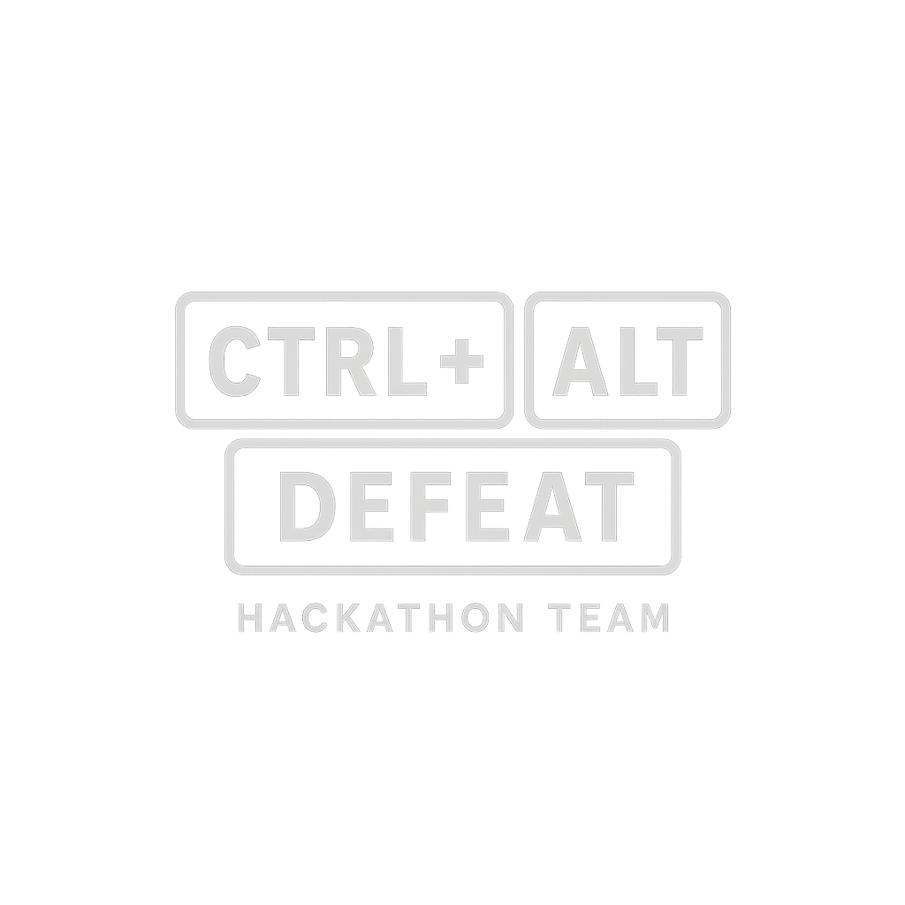
Autonomous Systems Testing – Benefits
Scale and speed of testing
Discovery – hidden/edge case failures
Adaptive scenario generation
Continuous testing
Applications:
CAA
Test scenario development
Completeness/Boundary/Sweetspot Id
Data analysis

Slide 63
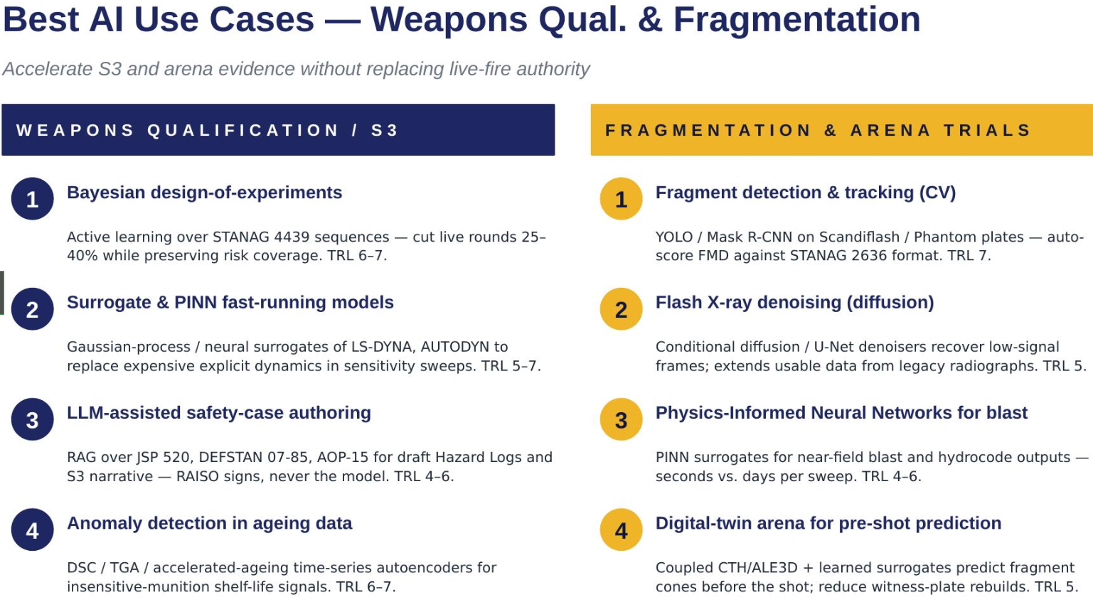

Slide 64
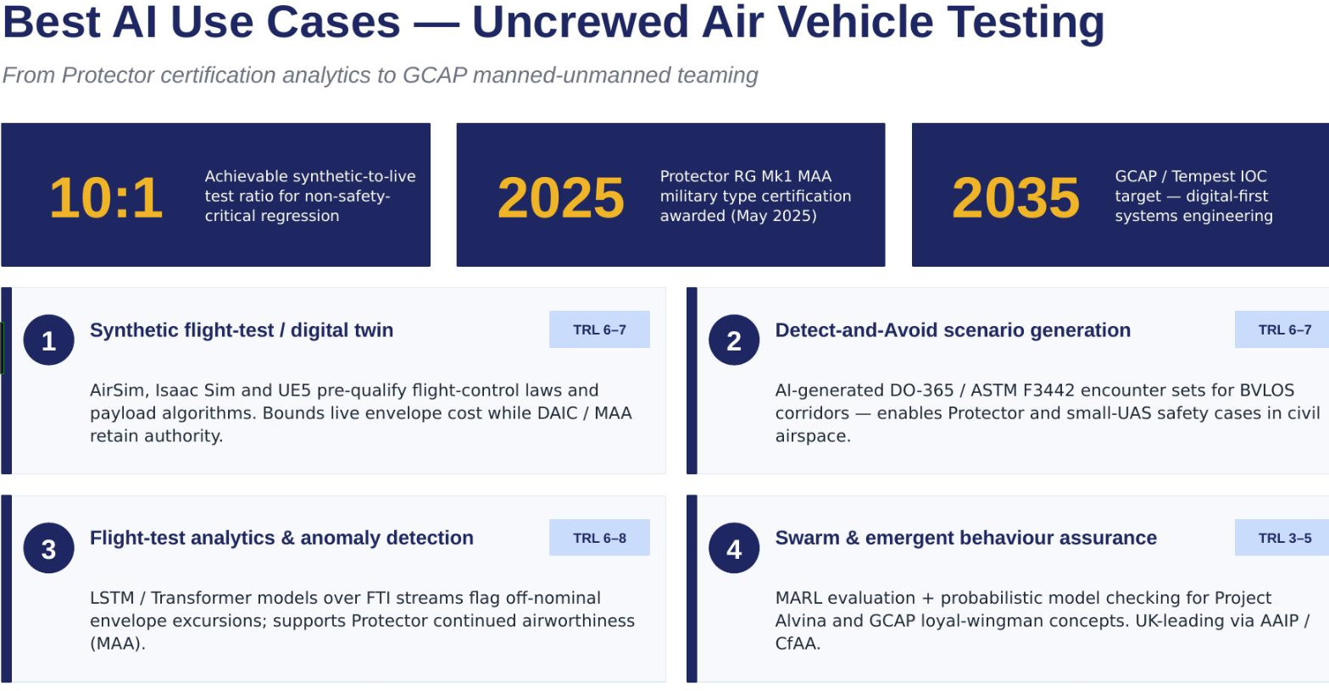

Slide 65
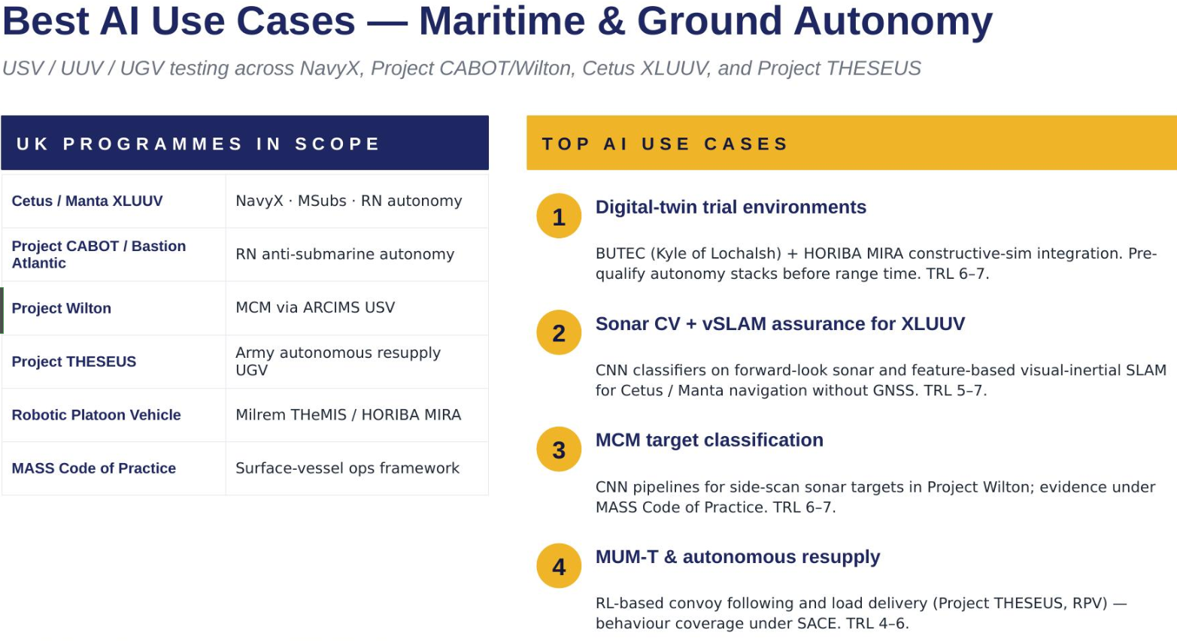

Slide 66
Autonomous Systems Testing – Challenges
Reality Gap (“It Worked in the Sim…”)
Scenario Coverage ≠ Scenario Relevance
Encoding Operational Intent Is Hard
Bias and Blind Spots in Scenario Generation
Validation of the Test Generator Itself
Explainability and Reproducibility
Over‑Optimisation and Adversarial Artefacts
Safety and Escalation Risks
Human Trust and Organisational Acceptance
Cost, Complexity, and Integration Debt

Slide 67
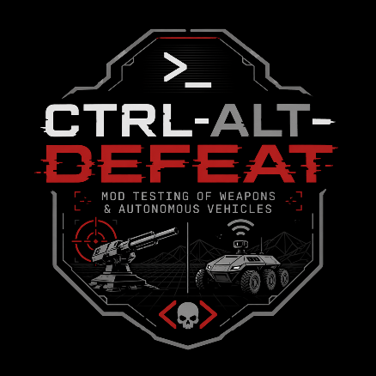
Selected Use Case
Autonomous Systems

Slide 68
User Story
Joint Approval Workbench – Purpose & Requirements
Role & Context
Lead Inspector (MAA RPAS) assessing BVLOS autonomous swarm trials across segregated and non‑segregated airspace.
Joint review with CAA AAA and Flight Ops to issue or refuse a Military Permit to Fly (MPTF).
What the Workbench Must Do
Ingest & structure applicant artefacts: safety case, JARUS SORA, autonomy assurance (SACE/AMLAS), DAA evidence, C2 analysis, swarm‑behaviour envelope, CAP 1616 material.
Cross‑check compliance with: RA 1000/1600/2300 series, DEFSTAN 00‑970 Pt 9, CAP 722 suite, JSP 936 Pt 1, AOP‑15/Art 36 (if armed).
Identify issues: residual risks, unresolved hazards, extrapolation beyond tested envelope, weak claim‑to‑evidence traceability.
Generate a decision record: conditions, operating limits, review triggers, rationale in clear engineering language.
Outcome / Value
Enables a defensible MPTF decision grounded in ALARP, Meaningful Human Control, and Duty Holder accountability.
Protects third‑party airspace users and the public.
Provides a transparent audit trail for RTS Authority, DASB, Ministers, and any future investigation.

Slide 69
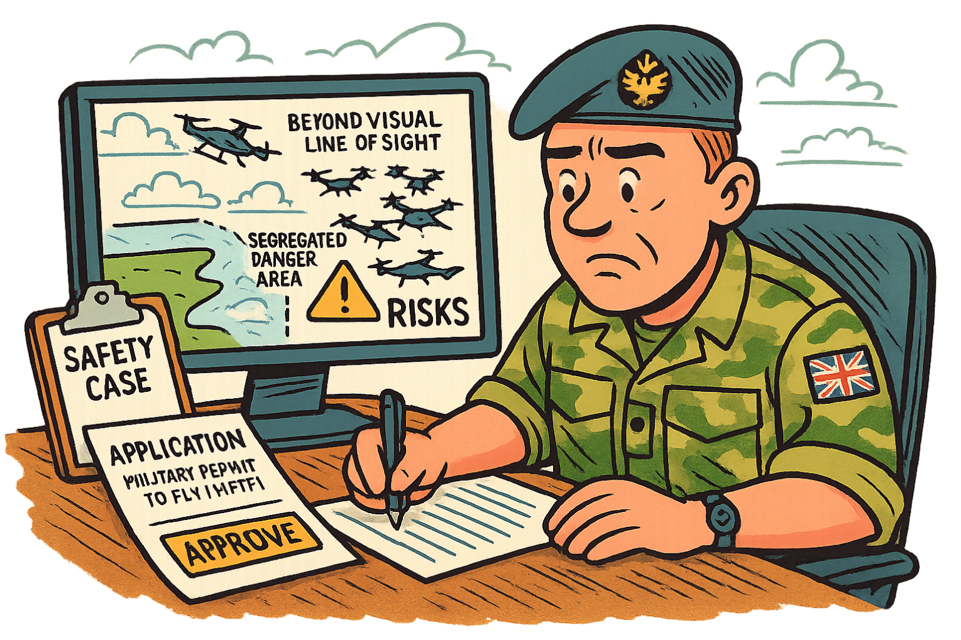
User Story

Slide 70
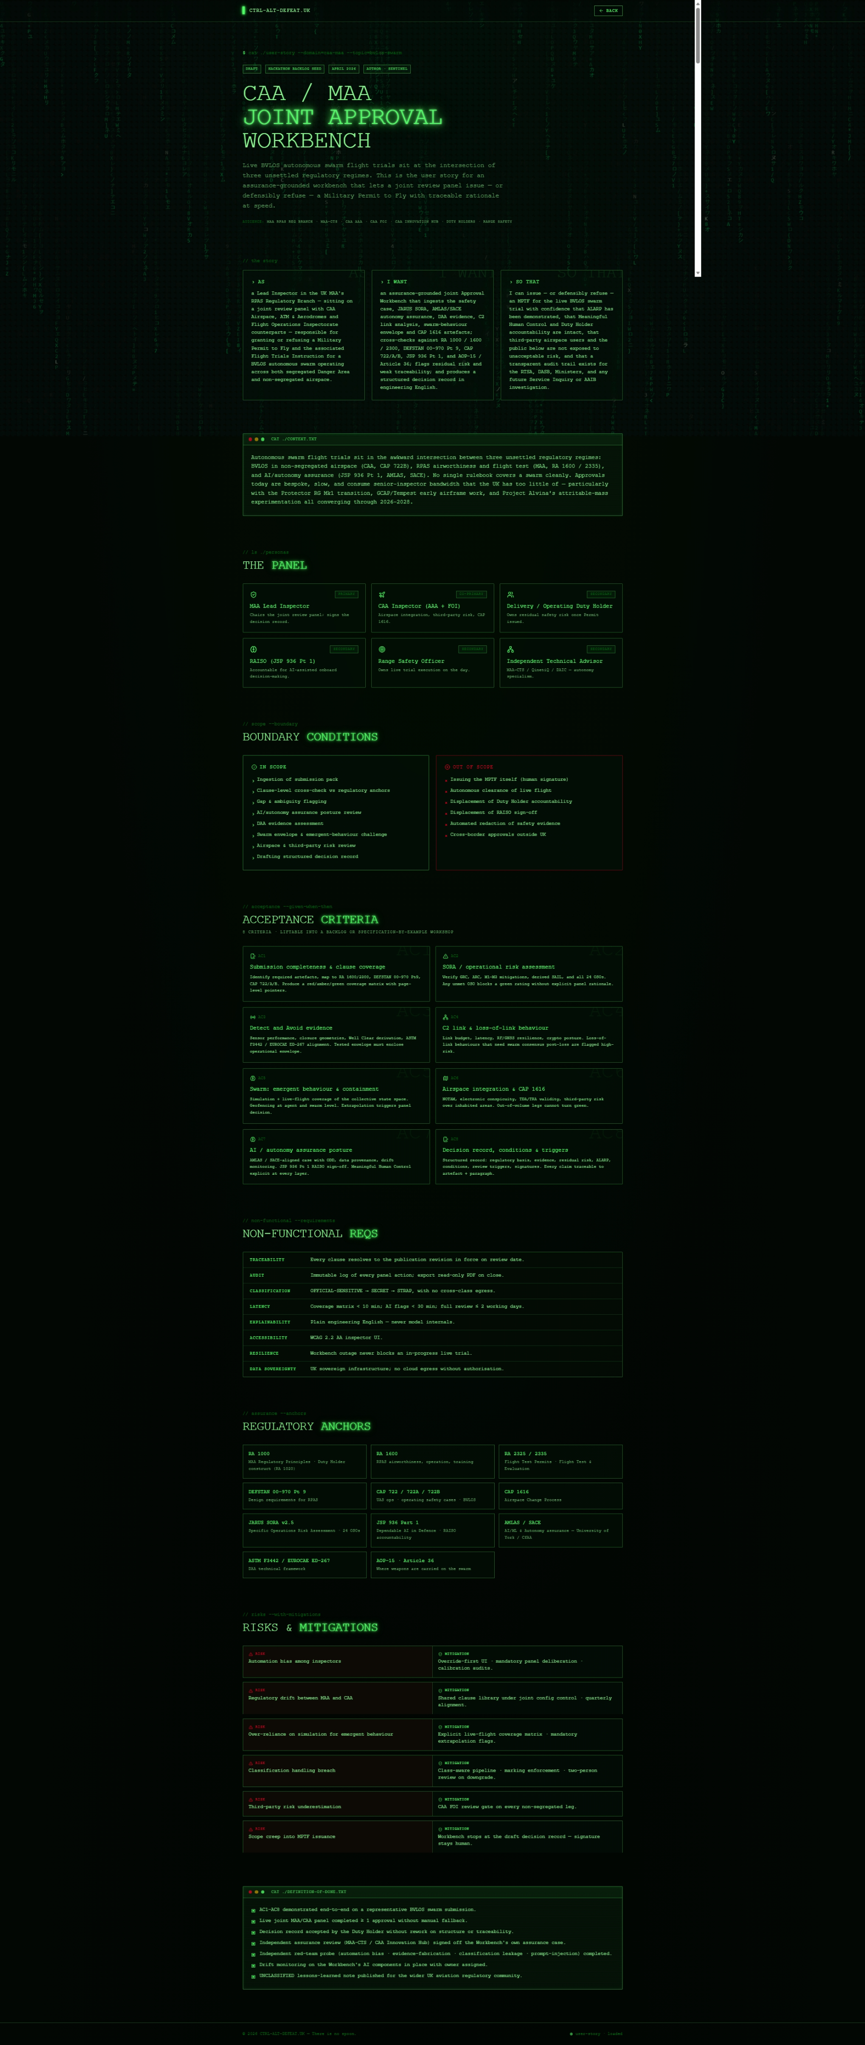

Slide 77
Data
Ingests
safety case,
JARUS SORA package,
SACE- or AMLAS-aligned autonomy assurance case,
Detect and Avoid (DAA) evidence,
command-and-control (C2) link analysis,
swarm-behaviour envelope,
and CAP 1616 airspace change artefacts.
Cross-checks against
RA 1000 / 1600 / 2300 series,
DEFSTAN 00-970 Part 9,
CAP 722 / 722A / 722B,
JSP 936 Part 1,
and AOP-15 / Article 36 where munitions are carried
Task
flag residual risks, unresolved hazards, extrapolation beyond the flight-tested envelope, and weak traceability from claim to evidence,
and produce a structured decision record with conditions, operating limits, review triggers, and rationale captured in engineering English

Slide 78
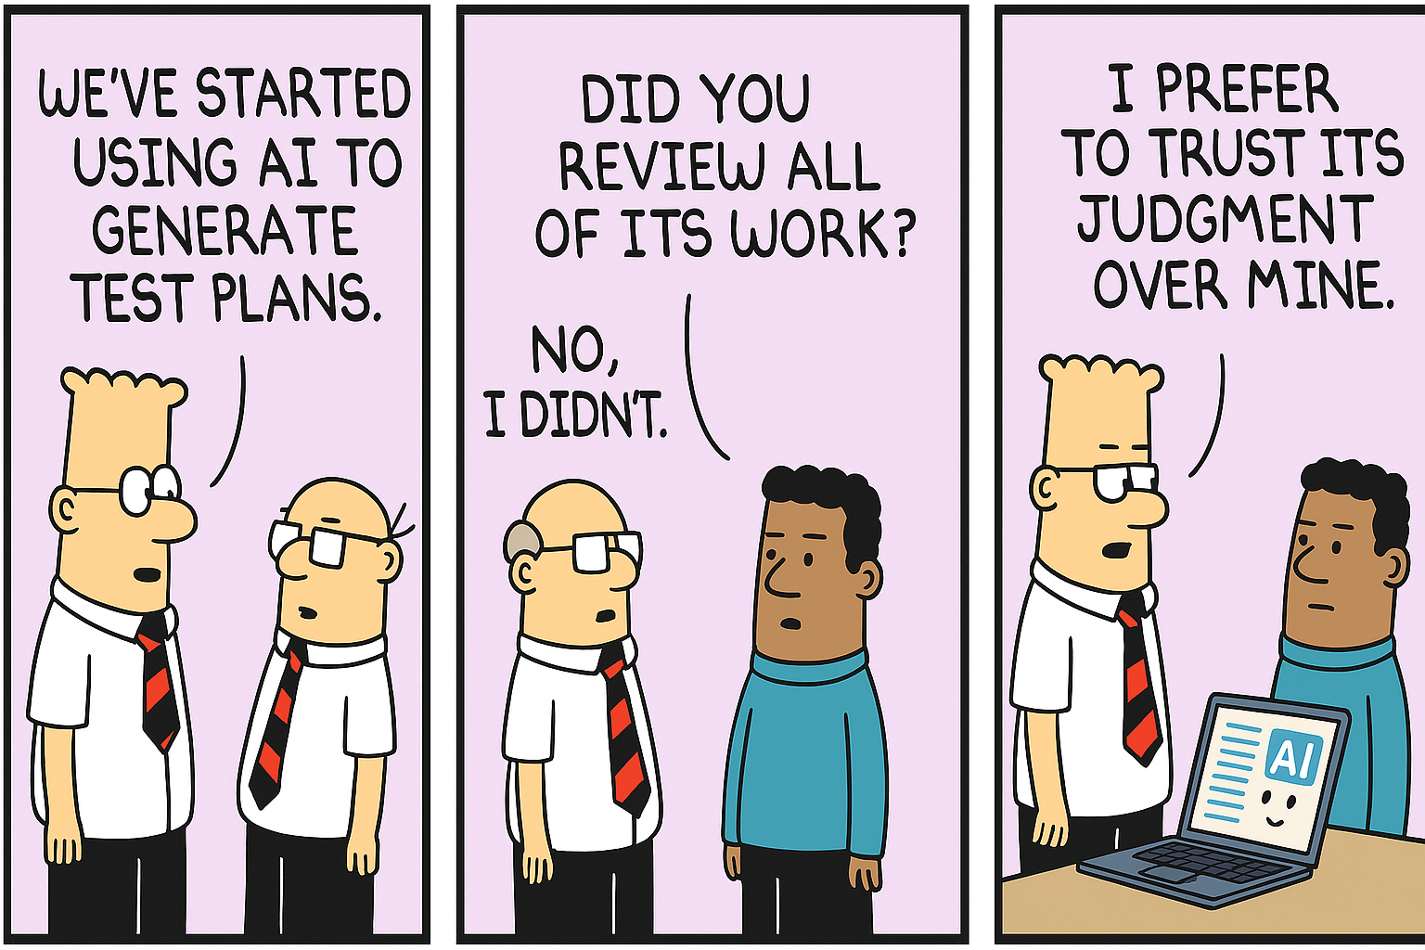
To AI or not to AI – Optional Answer sheet
Where are you using (or want to use) AI within the next 5 years?
Software development and deployment
T&E data analysis real-time and historic
    More data in shorter time – greater insight
    Decision making, security, safety
      Inform T&E safety decisions for activities and trials
      Avert/mitigate safety and cyber risks
    Review historic research papers and create new
Reference JSP936 to meet compliance when evaluating AI systems
T&E research and assistant
NOT
    For now - higher class networks
    Safety and cyber sign off

